Slide 1
Data Structures. (H16Y 35)
Week 8 (Block 2)

Slide 2
To Cover …
ADT Implementation in C#
ADT – Array Data Structure
ADT – Linked list Data Structure

Slide 3
Data Structures.
Abstract Data Types (ADTs)

Slide 4
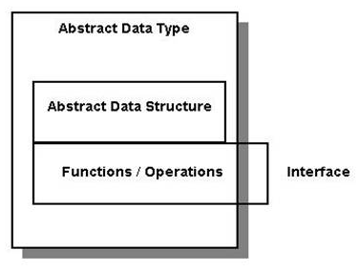
What is Abstract Data Type (ADT) ?
An ADT is considered abstract because the operations performed on it are separated from the underlying implementation
Most data-structure ADTs can be implemented using either a contiguous (array-based) or linked-data representation
An ADT hides the implementation of a data structure behind a well-defined interface.
Diagrammatic representation of ADT

Slide 5
ADT Structure.
ADT structure comprises of the following:
A name (the name of the ADT)
The data type(s) represented by a collection of data, which is structured in some manner [each type has been previously defined in a ADT (or it is a primitive type)]
Functions that operate on the data [the functions will specify the domain (parameters) and range (return type)]
Preconditions for each of the functions
Post-conditions for each of the functions
Error conditions that we need to consider.

Slide 6
Types of ADT.
Stack ADT
Queue ADT
List (Linked List) ADT
Set ADT
Map ADT
Tree ADT

Slide 7
ADT – Data Structures
Array ADT
List (Linked List) ADT

Slide 8
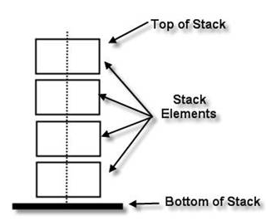
Stack ADT.
A linear sequence of arbitrary number of items, whose access procedures have a last-in, first-out (LIFO) behaviour.
A stack is either empty or it consists of two parts –
a top element
stack (the remaining elements).
The elements in a stack may be of any type, but all the elements in a given stack must be the same type
ADT Representation
LIFO – Last in First Out
If different boxes are stacked on top of one another, the last box to be added to the stack will have to be the first to be removed from the stack

Slide 9
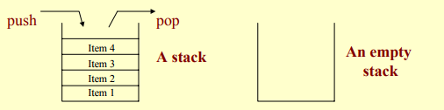
Stack ADT – Cont’d
The ADT Stack is a linear sequence of an arbitrary number of items, together with access procedures.
The access procedures permit insertions and deletion of items only at one end of the sequence (the “top”).
The stack is a list structure, sometimes called a last-in-first-out (or LIFO) list.
A stack is either empty, or it consists of a sequence of items. Access is limited to the “top” item on the stack at all times.

Slide 10
Stack ADT – Common Operations
In- Last In First Out (LIFO) concept.
Stack ADT Operations:
Push(Item): inserts an element
Item pop(): removes and returns the last inserted element
Item top(): returns the last inserted element without removing it
Integer size(): returns the number of elements stored
Boolean isEmpty(): indicates whether no elements are stored
Stack Error operations:
In Stack ADT, operations pop and top cannot be performed if the stack is empty, this can generate errors when prompted.

Slide 11
Stack ADT Interface – Implementation in C#
using System;
/*
using System.Collections.Generic;
using System.Linq;
using System.Text;
using System.Threading.Tasks;
*/
namespace <Your Initials>_ADTs
{
interface IStackADT
{
void push(int value);
int pop();
Boolean isEmpty();
int size();
}
}
Creating an ADT Interface to store Integers data sets

Slide 12
Stack ADT – Implementation in C#
Note:
To implement the ADT interface created, a data structure type must be specified (built as algorithm) for storing the integer data sets declared when creating the interface.
Example of data structure type –
Arrays DS – IntArrayList
LinkedList DS – IntLinkedList

Slide 13
Online - Resources
http://btechsmartclass.com/DS/U2_T2.html
http://btechsmartclass.com/DS/U2_T3.html

